Slide 1
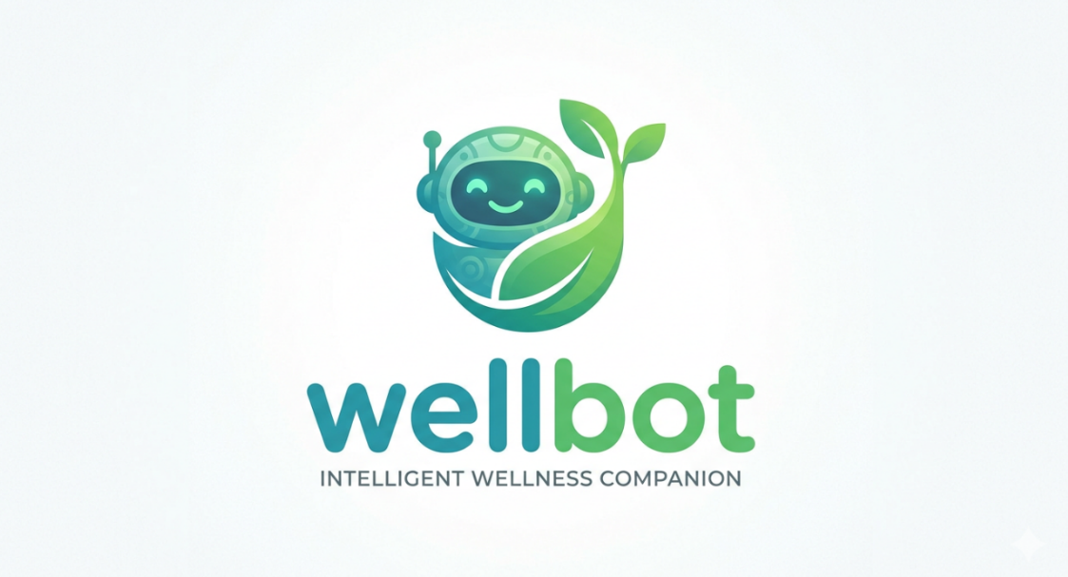
🌿 WellBot
AI Powered Wellness Chatbot Platform

Slide 2
Batch number 13 // TEAM A
GROUP MEMBERS NAME
1. Avinash
2. Harika
3. Sameer
4. Sakshi
5. Tejaswini
6. Apeksha

Slide 3

Project Overview
What the system does:
AI-based wellness assistant
Chatbot for health guidance
Prescription image analysis
User wellness dashboard
Admin monitoring system

Slide 4
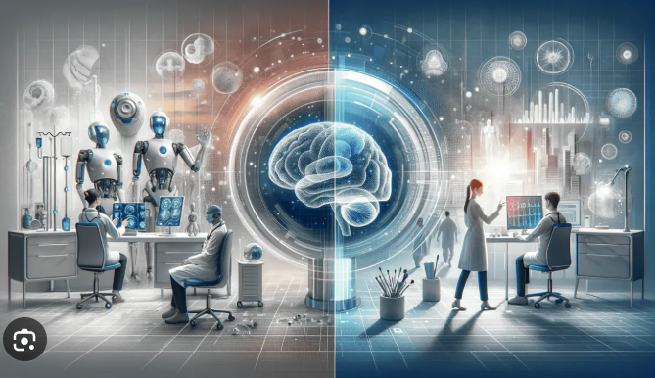
Problem Statement
People struggle to understand prescriptions
Limited access to quick health advice
No centralized AI wellness platform
Lack of personalized health tracking

Slide 5





WellBot – AI Powered Wellness Chatbot Platform
An intelligent wellness assistant combining AI-powered chatbot technology with advanced health analysis capabilities. WellBot provides users with instant access to health guidance, symptom assessment, and personalized wellness monitoring through a secure and intuitive platform.
AI Wellness Assistant
Conversational chatbot providing instant health guidance and support
Prescription Analysis
Intelligent image recognition for medication and prescription review
Wellness Dashboard
Personalized health tracking and user wellness analytics
Symptom Checker
AI-powered symptom assessment and preliminary health analysis
Admin Monitoring
Comprehensive system oversight and user management tools

Slide 6

System Architecture
WellBot employs a hybrid AI architecture that combines multiple language models and scalable database infrastructure to deliver reliable healthcare assistance.
MongoDB Database
Stores patient and session data
User Interface
Intuitive frontend for users
Groq • Gemini • Ollama • OpenAI
Multiple AI provider endpoints
WellBot System Architec ture
Frontend Dashboard
Displays patient interactions
AI Model Router
Routes queries to providers
Flask Backend API
Handles requests and logic
O1
O2
User Interface
Intuitive frontend for user interaction and health queries
Frontend Dashboard
Responsive web interface with wellness tracking features
O3
O4
Flask Backend API
RESTful API handling requests and business logic
AI Model Router
Intelligent routing to optimal AI provider based on query type
O5
OG
Multi-AI Integration
Hybrid architecture using Groq, Gemini, Ollama, and OpenAI
MongoDB Storage
Secure, scalable NoSQL database for user data and health records

Slide 7
Transforming Healthcare Access
WellBot represents the future of accessible healthcare technology, combining intelligent AI assistance with secure, real-time health monitoring to create a comprehensive wellness platform.
AI-Powered Healthcare Assistant
Advanced natural language processing enables accurate health guidance and symptom assessment
Real-Time Health Monitoring
Continuous wellness tracking with instant alerts and personalized health insights
Multi-Language Accessibility
Built-in language translation ensures healthcare assistance for diverse populations
Secure & Scalable Architecture
Enterprise-grade security with hybrid AI infrastructure supporting growth
Intelligent Admin System
Comprehensive monitoring dashboard for healthcare administrators and support teams
WellBot makes healthcare assistance faster, smarter,
and accessible for everyone

Slide 8

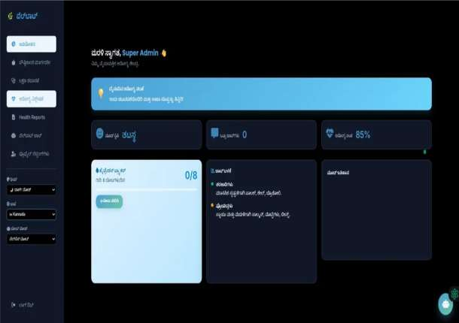

Multi-L anguage S upport
WellBot bridges the communication gap by offering
support in multiple languages.
English - Global accessibility
Hindi - National reach
Kannada - Regional localization
Spanish - International expansion
Enhancing communication for a healthier world.

Slide 9

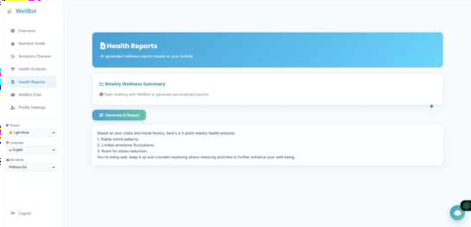

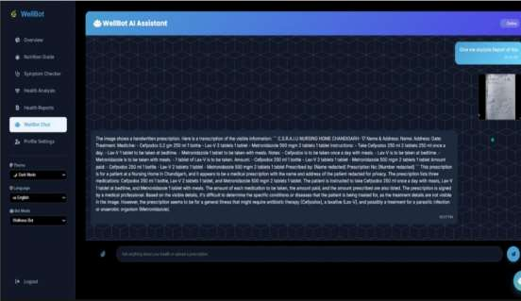
Dynamic Theme System
A customizable interface designed for user comfort and accessibility.
Light Theme - Professional and clean
Dark Theme - Reduces eye strain in low light
Automatic Adaptation - UI components adjust
instantly
Readability - High contrast for all environments

Slide 10

Real-Time Activity Tracking
👣
Footprint Counter
Tracks daily physical activity
Updates steps in real time Displays progress on dashboard Encourages healthy habits

Slide 11
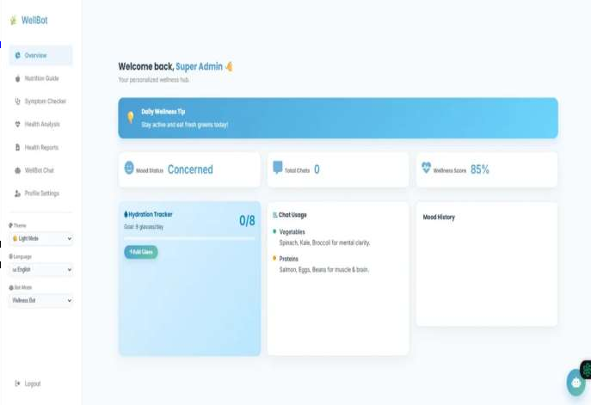
Admin Floating Chatbot Feature
Quick AI Interaction
Floating Icon - Accessible from any admin page
Instant Access - One-click chatbot testing Efficiency - Monitor AI behavior in real-time Seamless UI - Minimal impact on dashboard space

Slide 12
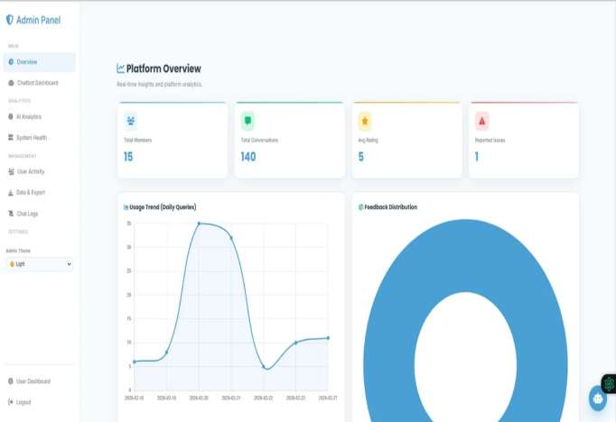




Admin Monitoring System
User Management - Track
regis trations and activity
Conversation L ogs - Monitor AI
interactions
System Analytics - Analyze us age
statis tics

Slide 13



Conclus ion
WellBot is an intelligent wellness platform designed to provide accessible healthcare assistance using AI technology.
Faster, Smarter, and Accessible Healthcare for Everyone.

